Slide 1
Embrace the Buzz: Building Modern Extensions for DotNetNuke
Ian Robinson

Slide 2

Ian Robinson
Session Feedback! http://www.stldodn.com
Twitter @irobinson
GitHub http://github.com/irobinson
StackOverflow Careers http://bit.ly/irobinson

Slide 3
Agenda
WebFormsMVP / Unit Testing
jQuery & Ajax
Razor Scripting Language

Slide 4
WebFormsMVP
Separation of concerns
Increased Testability
“Cleaner Architecture”
Retains basic characteristics of WebForms

Slide 5
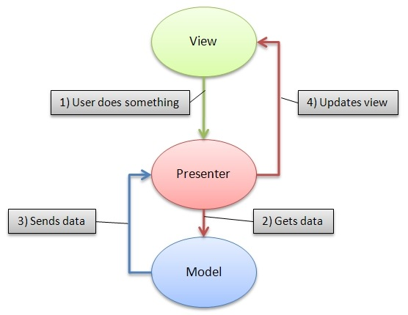
WebFormsMVP

Slide 6
WebFormsMVP Characteristics
Requires the view to give control to Presenter
The view and presenter pass around a model
Interfaces used for testability

Slide 7
WebFormsMVP in DNN
Introduced in Version 5.3
WebFormsMVP.dll bundled
Thin layer on top to provide context

Slide 8
Real World DNN Tests
DotNetNuke Core Tests
Vocabulary & Messaging Modules
DotNetNuke_Community_UnitTests.sln
Notes:
Find a relatively simple example from the DotNetNuke core to demonstrate the characteristics of unit tests.

Slide 9
BeerCollectionMVP
C#
WebFormsMVP
DotNetNuke Module
Web Application Project
Visual Studio 2010
MOQ & MbUnit
http://github.com/irobinson

Slide 10
Key Take-Aways
Unit testing increases confidence in your code. Code is more changeable.
Therefore Unit Testing is a desirable practice
WebFormsMVP allows us to better conduct unit testing in DotNetNuke

Slide 11
Recommended Resources
Unit Testing
The Art of Unit Testing by Roy Osherove
Working with Legacy Code by Michael Feathers
WebFormsMVP
Podcast: Hanselminutes Episode 202
http://webformsmvp.com

Slide 12
“AJAX”
Does Web 2.0 even mean anything anymore? (Did it ever?)
Is it over the top animations?
Or is it a compelling user experience?
Taste still counts.

Slide 13
AJAX
Asynchronous server communication
ASP.NET Sans-Postbacks
More control / more work?
“Closer to the metal”
Notes:
Discussion point: who’s using “true hand crafted”ajax techniques? Who’s using big wrappers / rich user controls.

Slide 14
jQuery
JS Library
One way of doing things…
Ease of use
Adoption / Community
Documentation

Slide 15
jQuery AJAX
jQuery.get() //http get
jQuery.load() //load page
jQuery.post() //http post
jQuery.ajax() //ajax swiss army knife

Slide 16
jQuery AJAX Events
Global events for re-use
ajaxStart()
ajaxError()
ajaxComplete()
ajaxStop()

Slide 17
Working with Data
Building it all up on the client side.
jQuery.data()

Slide 18
Collecting Simple Data
AddUserName(string user)
var username = $(‘#username’).text();

Slide 19
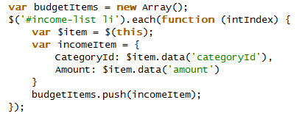
Collecting Complex Data

Slide 20
Services
ASMX
WCF
ASHX
ASPX
Pages Methods
It’s just http…

Slide 21
Service Proxy
Rick Strahl’s ServiceProxy.js
“JSON ServiceProxy to call WCF or ASMX JSON Services with Date Parsing”
http://codepaste.net/i89xhc

Slide 22
Patterns
Autocomplete
Form Submission
Drag and Drop
Auto-refresh
More patterns: http://ajaxpatterns.org/Patterns

Slide 23
More to Think About
Structuring JavaScript
JavaScript Combination/Minification
Creating jQuery plugins
Automated JavaScript Testing

Slide 24
Introducing…Razor
View Engine? Scripting language? Templating language?
Gu Says: “HTML generation … code-focused templating”
Clean syntax, fewer characters
Code is “first class”

Slide 25
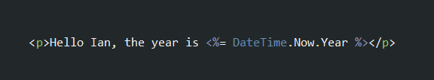
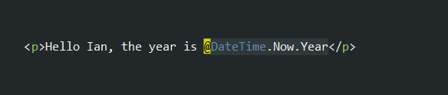
syntax
ASPX
Razor

Slide 26
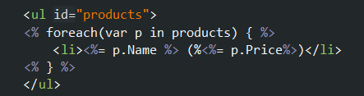
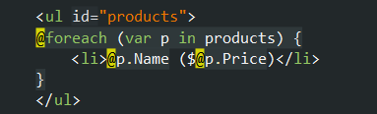
Syntax
ASPX
Razor

Slide 27
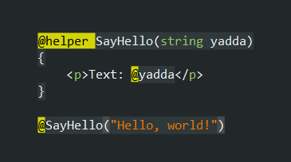
Helpers

Slide 28
ASP.NET MVC 3
Ships with choice of ASPX or Razor as view engine
Displaying and working with data (your model)
Cool: Automatic HTML Encoding
ASP.NET MVC 3 is an Open Source MVC Framework on .NET
Version 3 Released January 2011

Slide 29
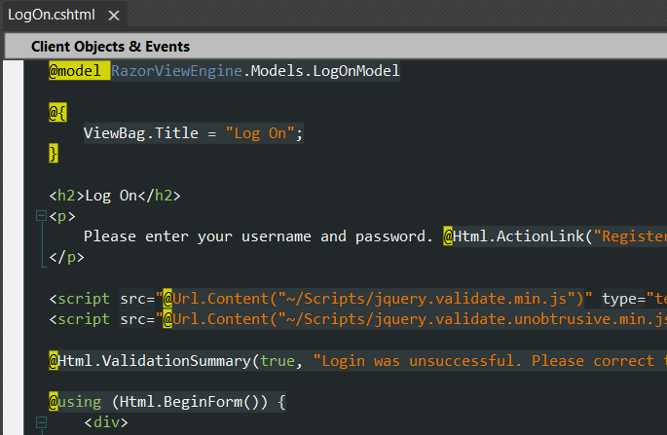
ASP.NET MVc 3 DEMO

Slide 30
WEB MATRIX
Think “PHP Story”
“Entry level” application creation
“Web Pages” .cshtml
In this world…
Razor scripting allows dynamic features

Slide 31
DotNetNuke
Enable light weight but powerful development
Not the new approach, but a new approach
Razor host module
Similar to web matrix style development
Less the nice IDE
Add DNN Context (API)

Slide 32
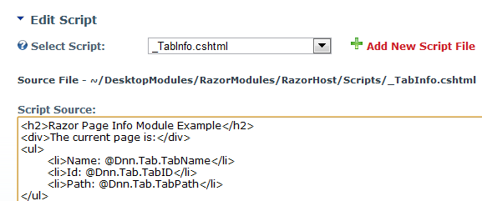
Razor host module

Slide 33

A razor module
MyModule.ascx
Inherits from RazorModuleBase
_MyModule.cshtml
Contains html/js/razor
Host -> Module Definitions
Create new module -> From Control

Slide 34
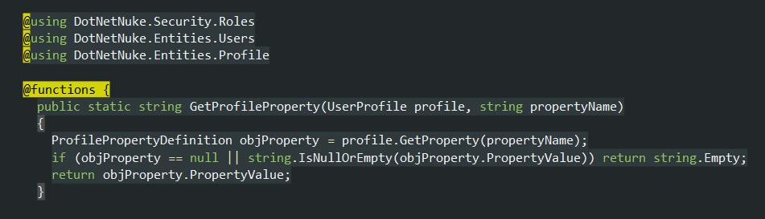
User map demo

